Slide 1
Project Ideas for Winter 2019
Each team member should come up with 3 ideas. Please use a slide for each idea to communicate your idea with pictures and text.

Slide 2
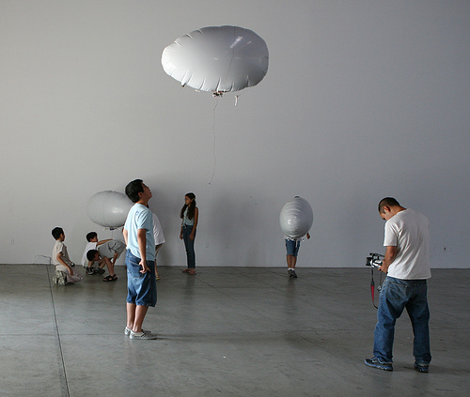
Chuck 1 - Blimp Bot Selfie
Basically a balloon that can navigate using motors. And can take selfies that it uploads to the internet.
There is a guide on how to make the bot by itself here: https://cdn.hackaday.io/files/255001090992000/BubberBot_Tutorial_V1-2.pdf
We would have to figure out how to make it work with a camera and the internet, and how to make it follow someone (possibly with bluetooth?). The instructions show how to make it track light or some types of cell phone activity.
Pros: Mostly step-by-step on robot building part. Cheap materials. Cool factor: Flying robot
Cons: The camera and the tracking part is an unknown. That part might be hard.

Slide 3
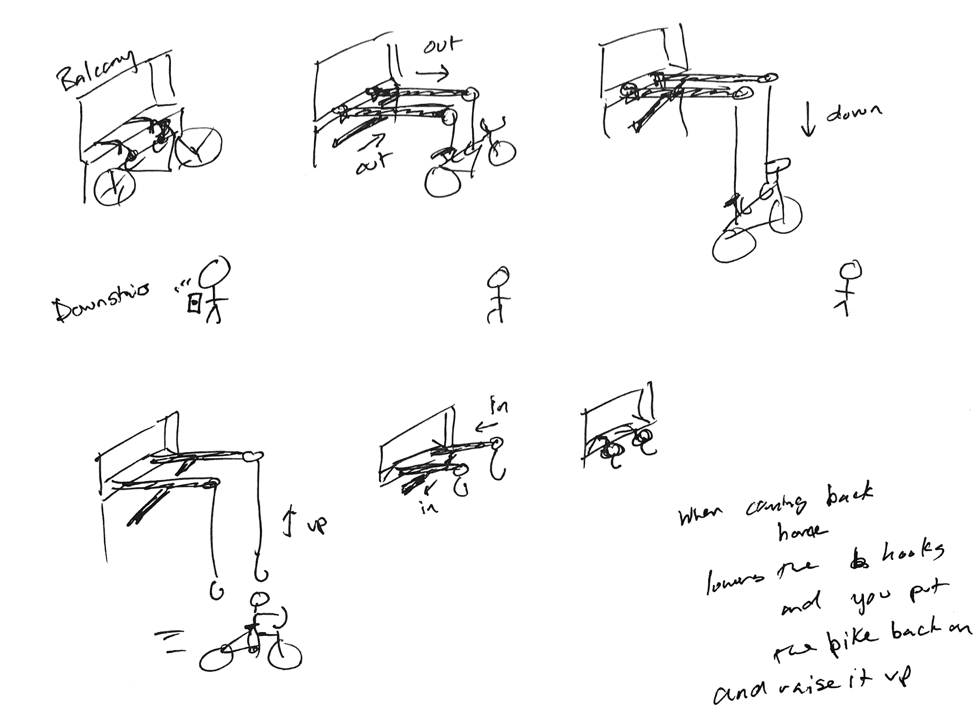
Chuck 2 - Balcony Bike Storage
Kind of like how you use a garage door opener to store your car. If you live in an apartment, and you want your bike you use a remote to lower it to you instead of dragging it downstairs or through an elevator. Then you use it to pull it back up again. Saves space on bike storage in your apartment and is more secure than locking your bike outside.
Pros: Dunno, just thought it would be useful.
Cons: Would need powerful motors. Not a Mech. E. so I don’t know how the hell it would work mechanically. lol.

Slide 4
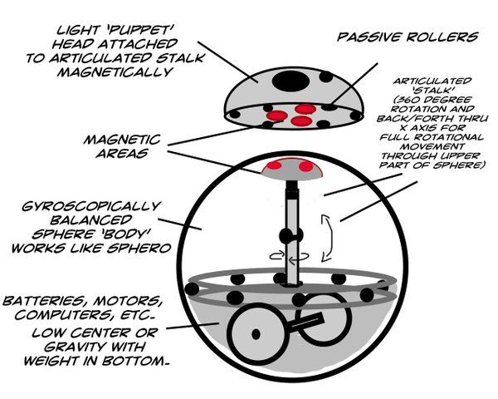
Chuck 3 - Cat Toy
Basically a Sphero Robot that just runs at random times of day that makes noises and stuff that makes the cat want to chase it.
I dunno, ran out of ideas.

Slide 5
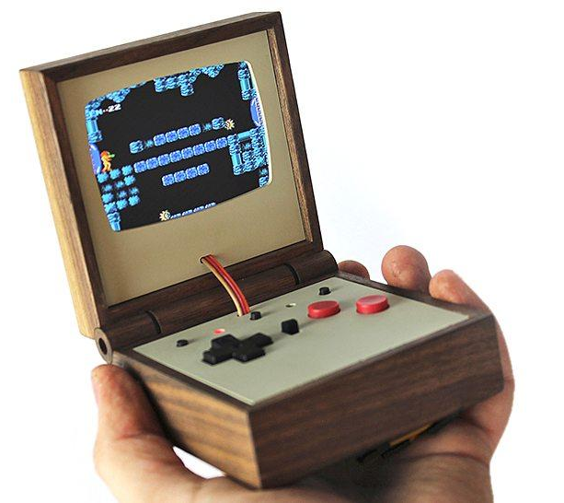
Matt 1-Handheld Video Game
Box could look like this or it could be Wii-U or PSP style handheld game in a wooden box. Basically we would use a larger TFT LCD screen or possible just an LED screen possibly touchscreen. The game could be just about anything as long as the graphics are 2-D style. We could find alternative graphics libraries as well use Object Oriented Programming (OOP) and flag-interrupt functions to build the game with possibly a better microprocessor.

Slide 6
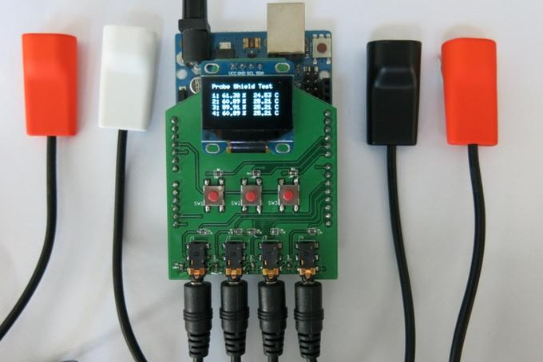
Matt 2-Wifi Data Logger Modules
Data logging devices are expensive ($1,000’s/unit) and only store data on local memory cards with limited memory capacity which is why it would be extremely useful to have a cheap data logger module that wrote continuously to a database online. Although most microprocessor pins cannot input very much voltage (usually between 0-5V) and lower voltages yield more inaccurate resolutions, we could use voltage comparator op-amp circuits paired with amplifier circuits to control what voltages go to what pins and output various voltage readings to an online server database. This could offer a low budget and highly useful solution to engineering companies that don’t have the budget for expensive equipment.

Slide 7
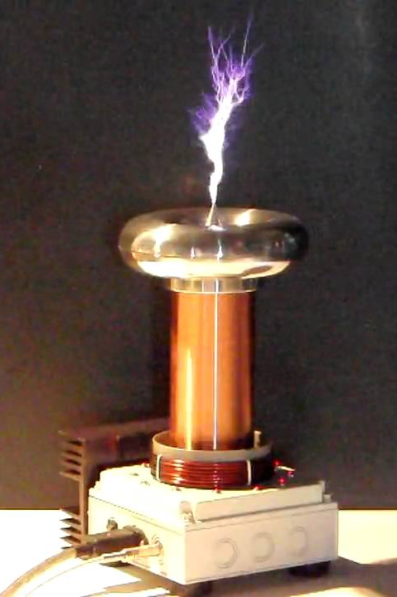
Matt 3-Musical Tesla Coil
We could build a tesla coil with controller that would input a music or file from the same folder as the source code (input via file name in the program) that the program would process the file into a sequential array of tones and play the array through the tesla coil. So far I don’t know too much about building tesla coils, how to get them to make tones, or how to process music files into arrays of probably integers, but it would be a great learning experience and would be a really cool and sort of dangerous project to execute.

Slide 8
Jesse 1 - Bluetooth Speaker

Slide 9
Jesse 2 - Inductive Charger

Slide 10
Jesse 3

Slide 11
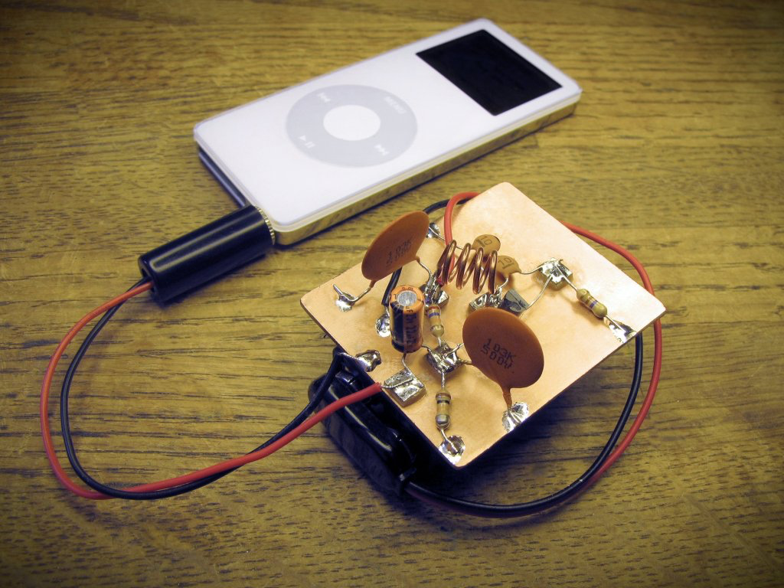
Edgar 1 - FM Transmitter
We could build a radio transmitter. Basically we build a circuit connect a 9v battery to it and a headphone jack to it, plug in a phone or music device and search for the broadcasting station manually using a radio.
Here’s a useful instruction site
https://makezine.com/projects/super-simple-fm-transmitter/
Here’s a video
https://www.youtube.com/watch?v=MMgzUGBfXiE

Slide 12
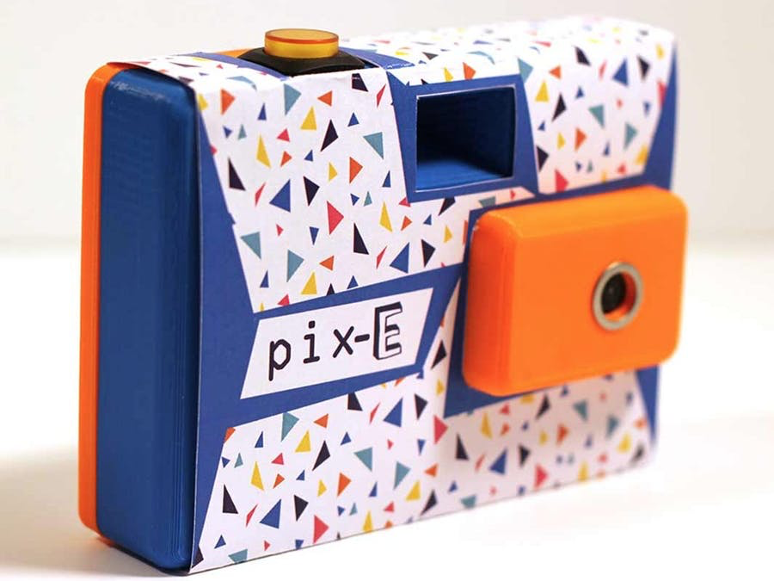
Edgar 2 - gif Camera
We could build a gif camera that makes gifs by taking pictures and we can have the gifs get posted online like twitter or saved onto an SD card. It uses a raspberry pi board and it connects to the internet like the Huza. We could 3D print the case and it doesn’t seem to hard to set. The code is also mostly written for us. We can mod it if we want to make the gifs longer etc.
website
https://www.hackster.io/nick-brewer/pix-e-gif-camera-323965
Video
https://www.youtube.com/watch?v=L-XnRj8Xrns

Slide 13
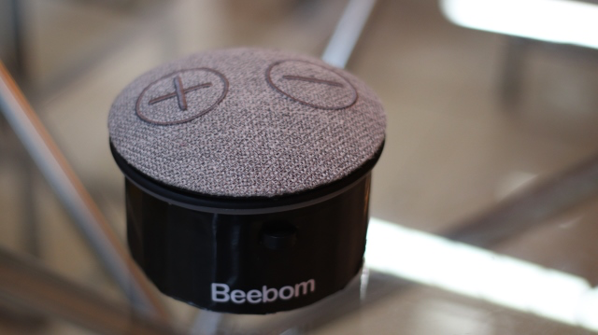
Edgar 3 - smart Assistant
We could make our own smart assistant. We can add either Amazon's Alexa or google assistant. It doesn’t seem to hard but we do need raspberry pi board, a couple of usbs, usb port, usb speaker, volume controls and we could 3D print the casing of it.
Websites
https://beebom.com/how-build-smart-speaker-alexa-google-assistant/
https://www.hackster.io/adylinn/diy-smart-assistant-speaker-lamp-google-home-or-alexa-34e44e
Video
https://www.youtube.com/watch?v=LoNjPXKaqSE

